Slide 1
Hadoop 101
Great Ideas….Simple Solutions

Slide 2
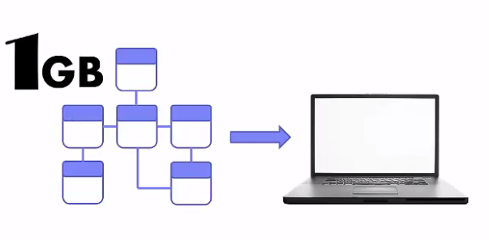
Data Stored in Relational Database
Simple Desktop Application
Application have no problem in Handling the load

Slide 3
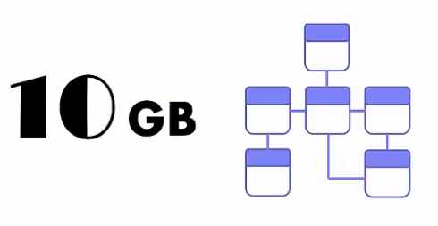
Server Class Application
Database is still relational to serve Application

Slide 4
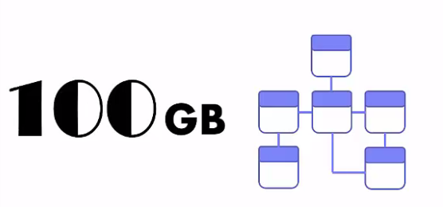

Data Size Increasing Rapidly
Scale Up and invested in larger Computer

Slide 5


Big Size Data
Data surpass the limit of your server.

Slide 6
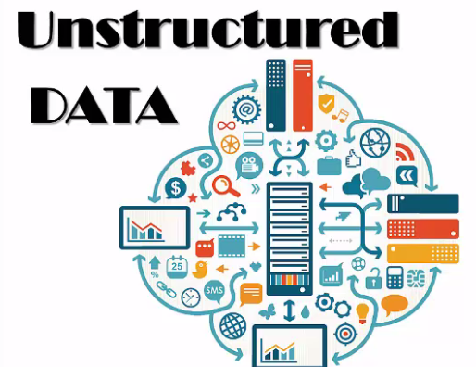
Data source from Internet
Facebook
Twitter
Sensors
…

Slide 7
We need information, you listen!!!
Management want information from Internet and RDBMS
HADOOP may be the Answer!!!

Slide 8
Hadoop
Google Foundation
Evolved in Yahoo
Written in Java
Base is Map Reduce Algorithm
Design to handled massive data in the form of structure, unstructured or semi structure(XML, JSON, …).

Slide 9
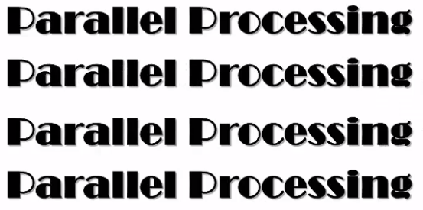

Hadoop do it great but a replacement!

Slide 10
What is BIG DATA
Huge in 100s of TB
Unstructured
Required fast processing

Slide 11
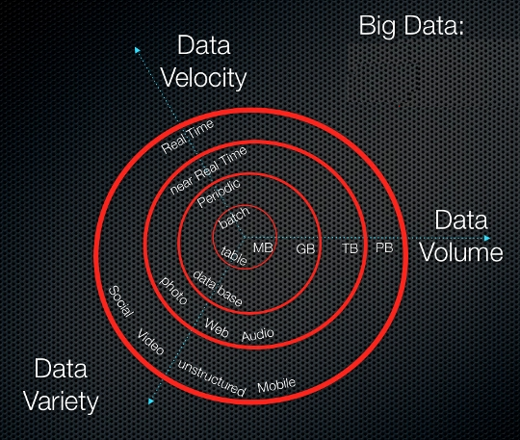

Slide 12
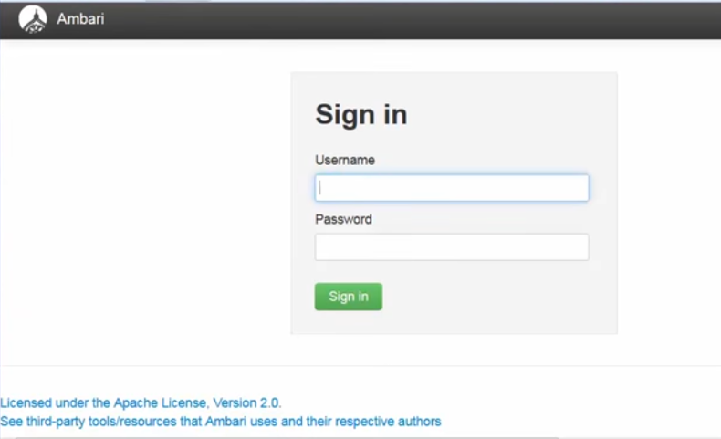
Hadoop Cluster

Slide 13
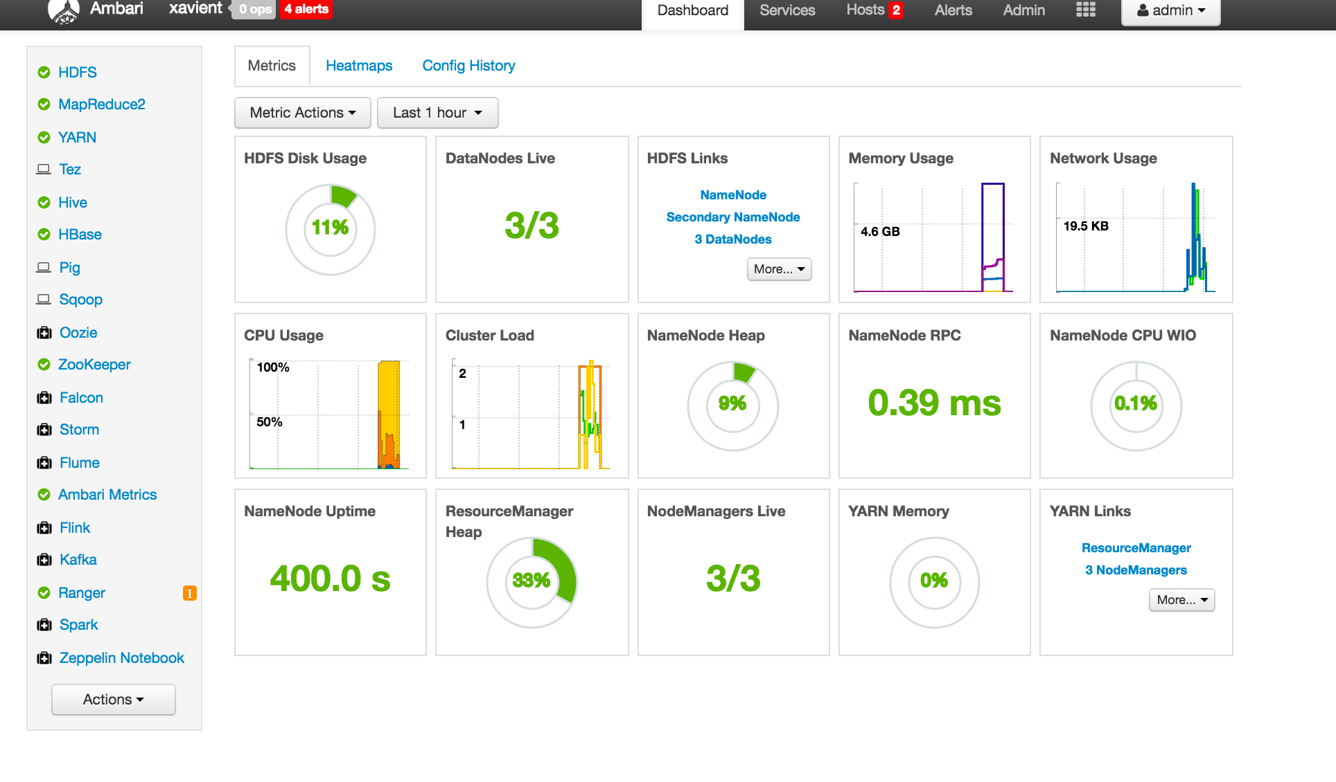

Slide 14
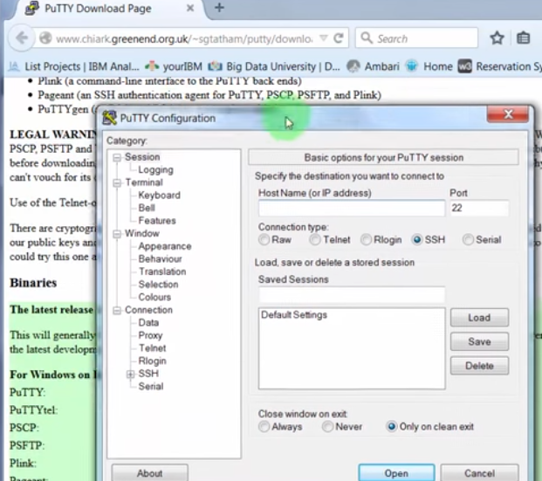
How to connect a Hadoop Cluster

Slide 15
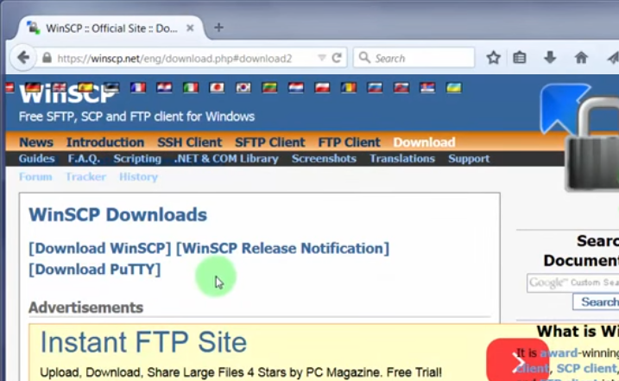
Transfer a File to Hadoop Cluster

Slide 16
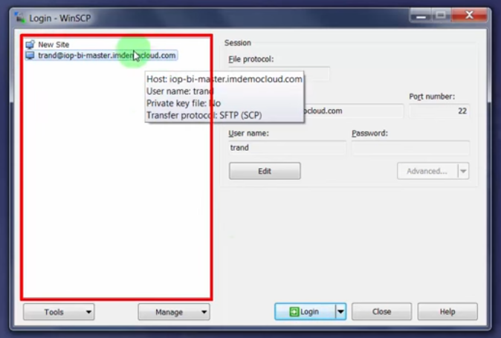
Login WinSCP

Slide 17
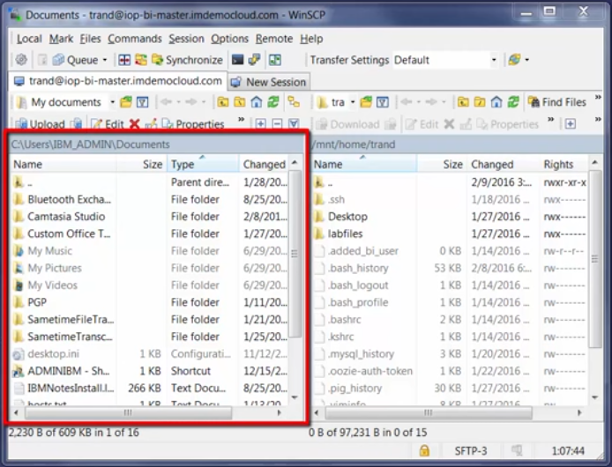
WinSCP View

Slide 18
Download Hadoop
http://hadoop.apache.org/releases.html
https://hortonworks.com/downloads/
http://www.cloudera.com/downloads.html
http://www-03.ibm.com/software/products/en/ibm-open-platform-with-apache-hadoop
Etc..

Slide 19
Setup Hadoop
Download Image is of minimum 8GB of RAM
Oracle Virtual Box
Ova image
VM ware
Vmdk image

Slide 20
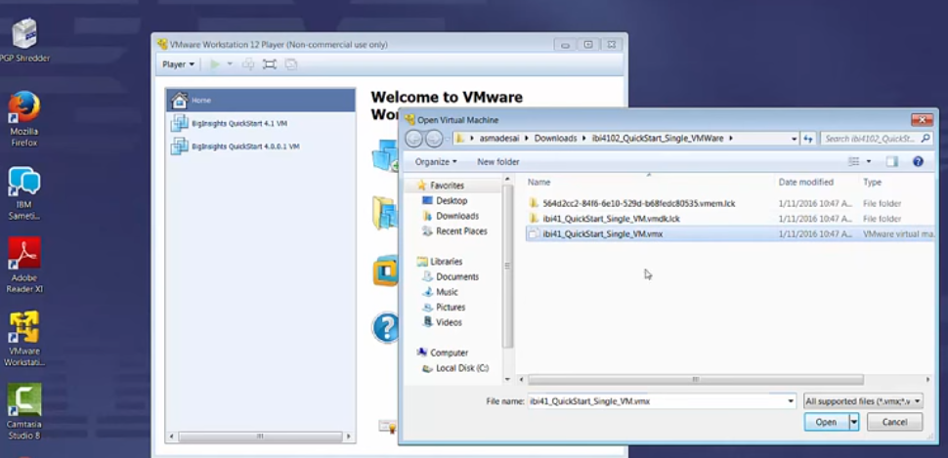
Run Hadoop VM

Slide 21
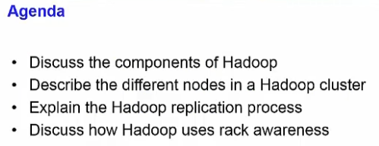
PART 2: Hadoop Architecture

Slide 22
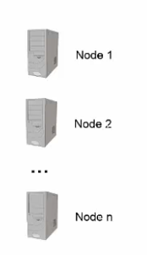
Lets have Terminology review

Slide 23
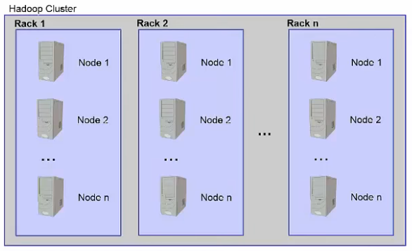
Hadoop Cluster is Collection of Racks

Slide 24
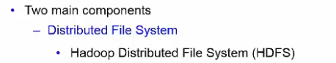
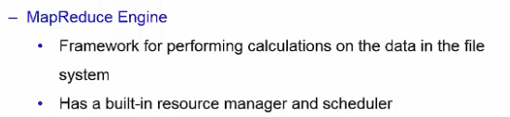
Hadoop 1 Architecture

Slide 25
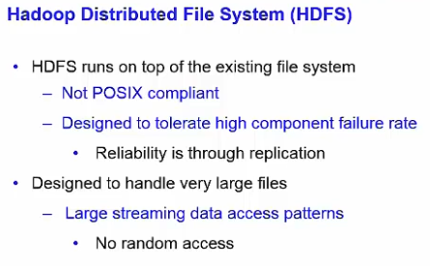
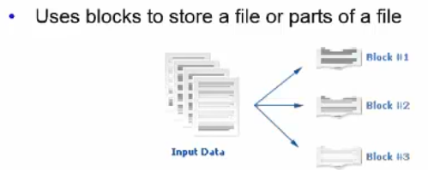
Components 1 - HDFS

Slide 26
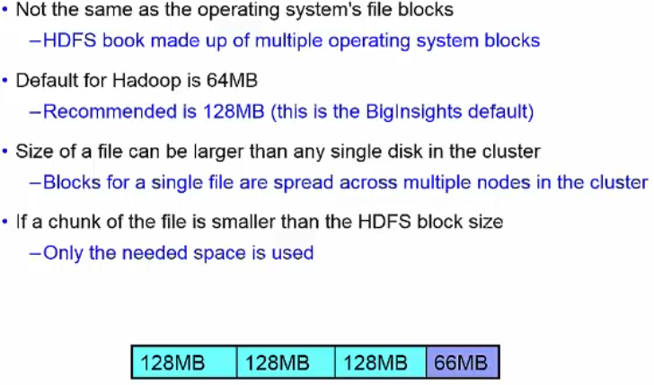
HDFS File Blocks

Slide 27
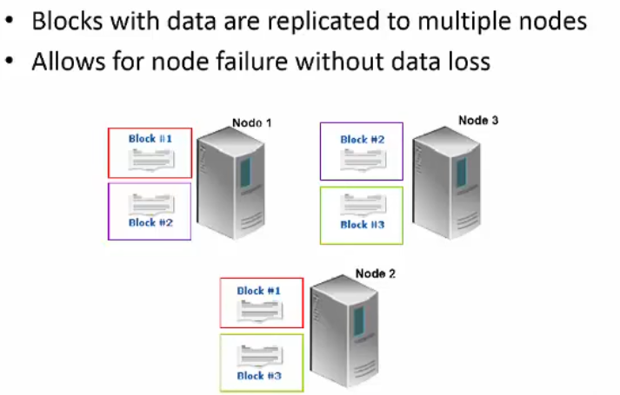
HDFS Replication

Slide 28
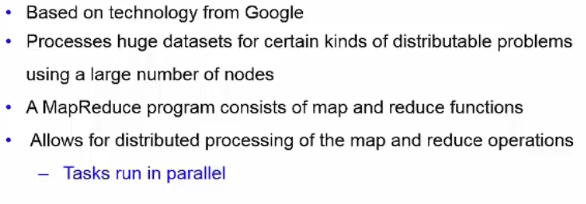
Map Reduce Framework

Slide 29



A MapReduce view
Solution 1: (Using map() and reduce()):-
Workers
Librarian

Slide 30


What is MapReduce?
Solution 2: (Using Map(), combine() and reduce()):
Workers
Manager
Manager
Supervisor
Supervisor
Librarian

Slide 31
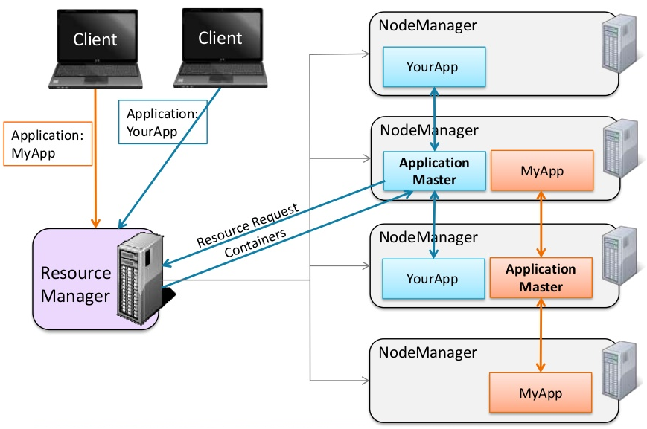
Hadoop 2 Job in Action- YARN

Slide 32
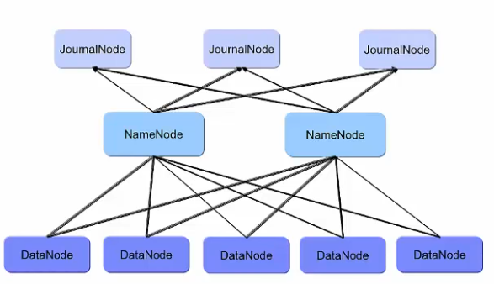
Hadoop High Availability

Slide 33
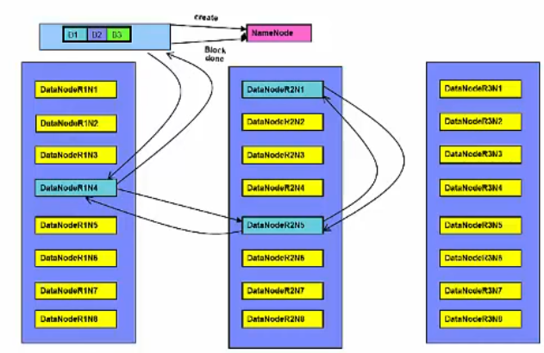
HDFS Replication

Slide 34
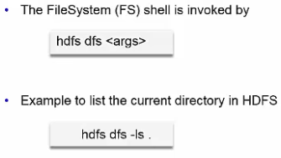
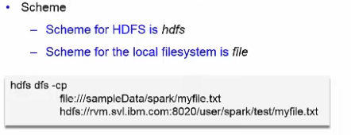
HDFS command line Interface

Slide 35
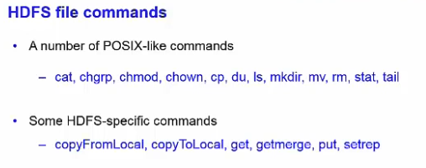
HDFS Command Line

Slide 36
HDFS commands in Action
Play E:\Projects\GIFS\HDFS_Commands_in_Action.gif

Slide 37
Run Hadoop Local VM
Run E:\Projects\GIFS\Lets_Boot_Local_Hadoop_VM.gif
Lets spend some time looking at Hadoop Components at local VM

Slide 38
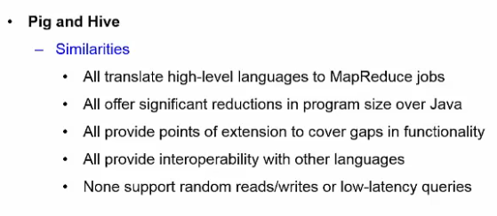
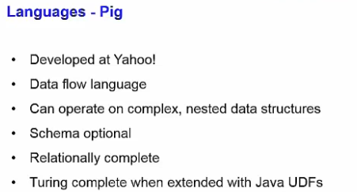
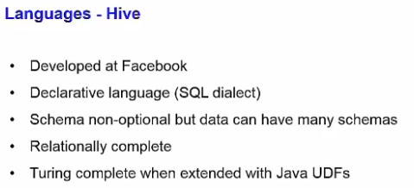
Components in Hadoop

Slide 39
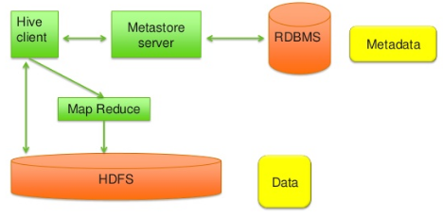
Hive Architecture:-
File format supported by Hive:- txt, Sequence File, RC, ORC, PARQUE, AVRO and custom…
Type of Tables in Hive:- Managed and External
39

Slide 40
Hive Objects and Properties:-
File format supported by Hive:- txt, Sequence File, RC, ORC, PARQUE, AVRO and custom…
Type of Tables in Hive:- Managed and External
Functions and Analytical functions supported in Hive
Rank, Dense_Rank, Lag, Lead etc…
40

Slide 41
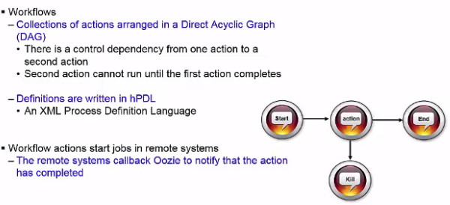
Oozie

Slide 42
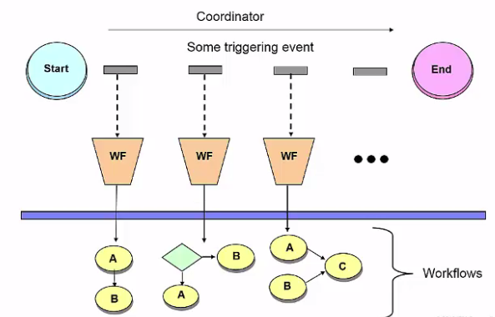
Oozie Coordinator

Slide 43
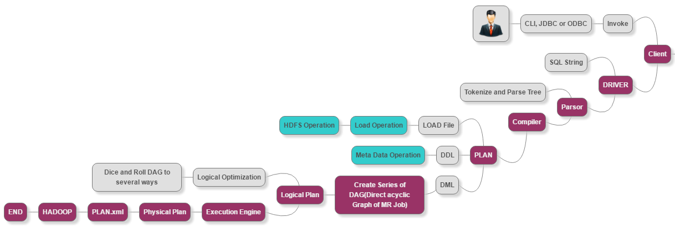
Hive Query Execution Flow:-
43

Slide 44
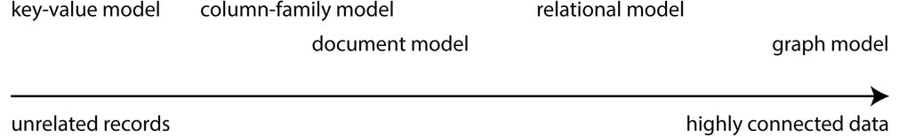
NoSQL? Understanding the trade-offs…
• ACID for RDBMS
• CAP theorem for Distributed System
• BASE for NoSQL
Consistency
Availability
Partition Tolerance
HBase is a CP-type system
44

Slide 45
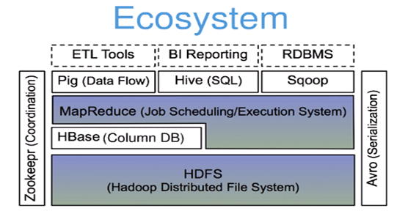
HBase! Overview
HBase is a distributed column-oriented data store built on top of HDFS
HBase is an Apache open source project whose goal is to provide storage for the Hadoop Distributed Computing
Data is logically organized into tables, rows and columns
HBase is built on top of HDFS
HBase files are internally stored in HDFS
45

Slide 46
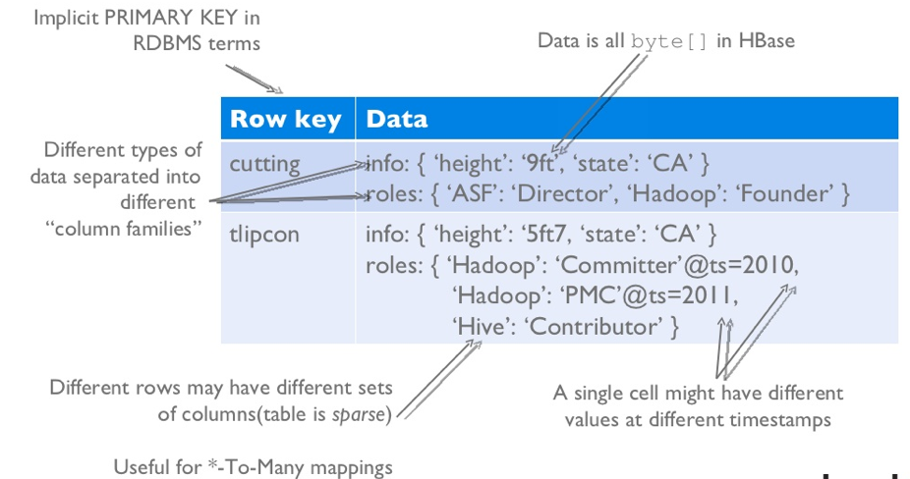
HBase Data Model
HBase is based on Google’s Bigtable model
Key-Value pairs
46

Slide 47
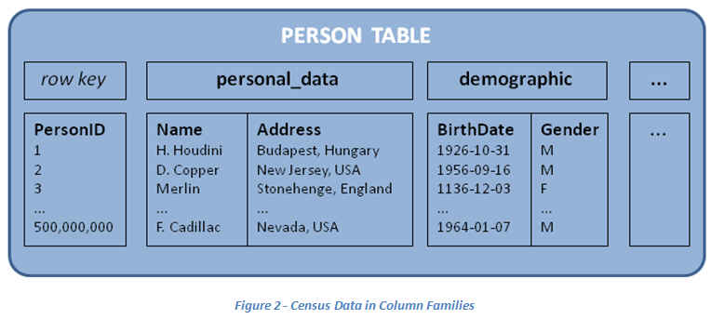
HBase: Keys and Column Families
Each record is divided into Column Families
Each row has a Key
Key
Byte array
Serves as the primary key for the table
Indexed far fast lookup
Column Family
Has a name (string)
Contains one or more related columns
Column
Belongs to one column family
Included inside the row
familyName:columnName
Version Number
Unique within each key
By default→ System’s timestamp
Data type is Long
Value (Cell)
Byte array
Each column family consists of one or more Columns
47

Slide 48
Three Major Components
The HBaseMaster
One master
The HRegionServer
Many region servers
The HBase client
Region
A subset of a table’s rows, like horizontal range partitioning
Automatically done
RegionServer (many slaves)
Manages data regions
Serves data for reads and writes (using a log)
Master
Responsible for coordinating the slaves
Assigns regions, detects failures
Admin functions
48

Slide 49
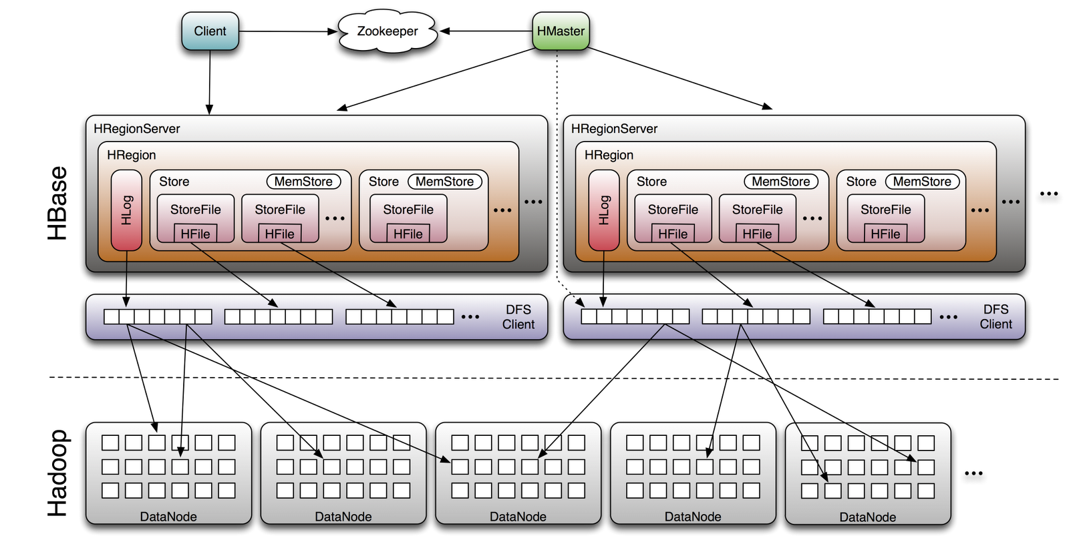
Hbase Big Picture
49

